Slide 1


Quality Assurance for Mass-Reared Parasitoids and Predators
Norm Leppla, Director
UF/IFAS Statewide IPM Program
Entomological Society of America
National Meeting
Austin, Texas

Slide 2
QA for Mass-Reared Parasitoids and Predators
A Complete Quality Assurance System
Customer Involvement in Quality Assurance
Quality Assessments of Mass-Reared Natural Enemies
Research on Quality Assessment for Mass-Reared Parasitoids and Predators

Slide 3
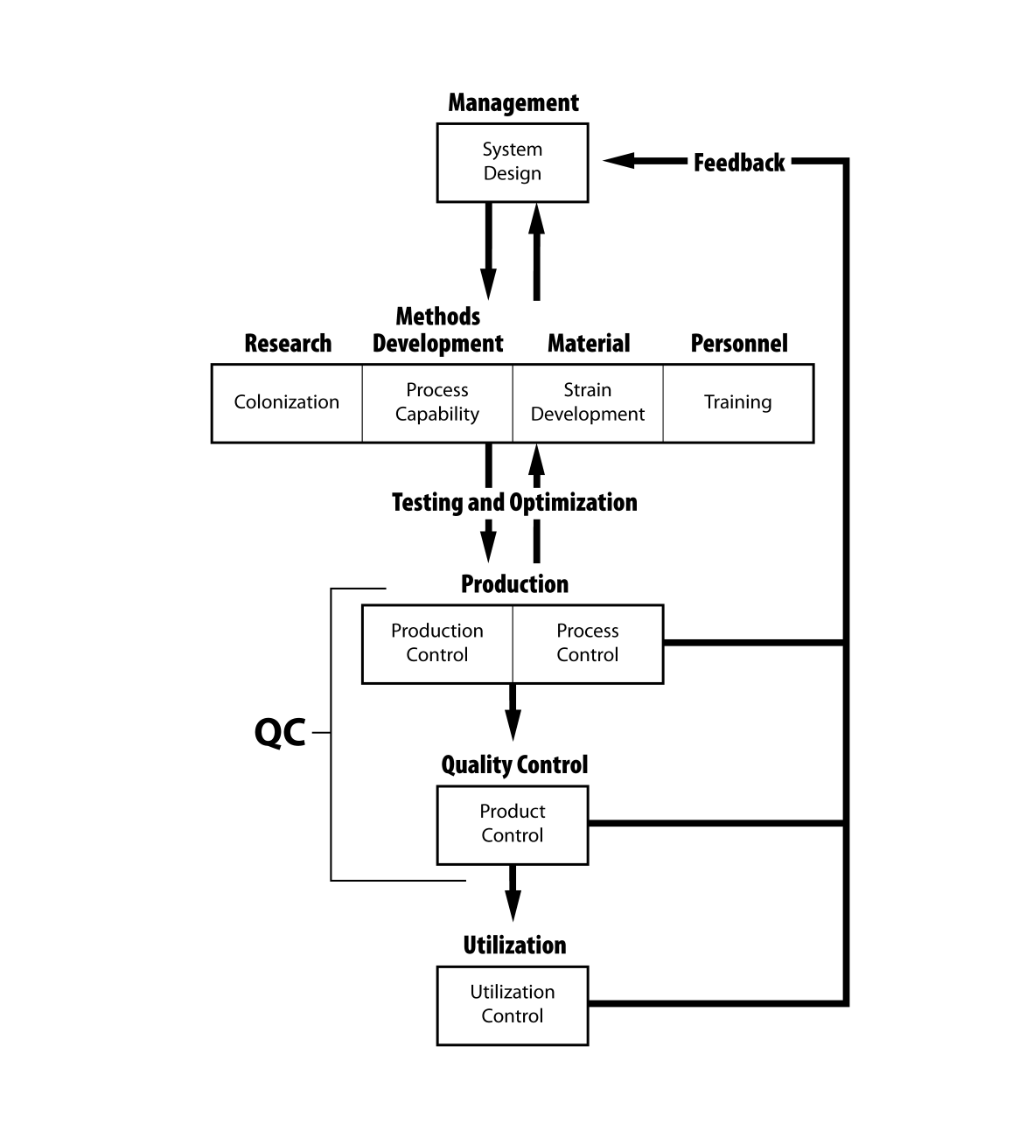
A Complete QA System

Slide 4
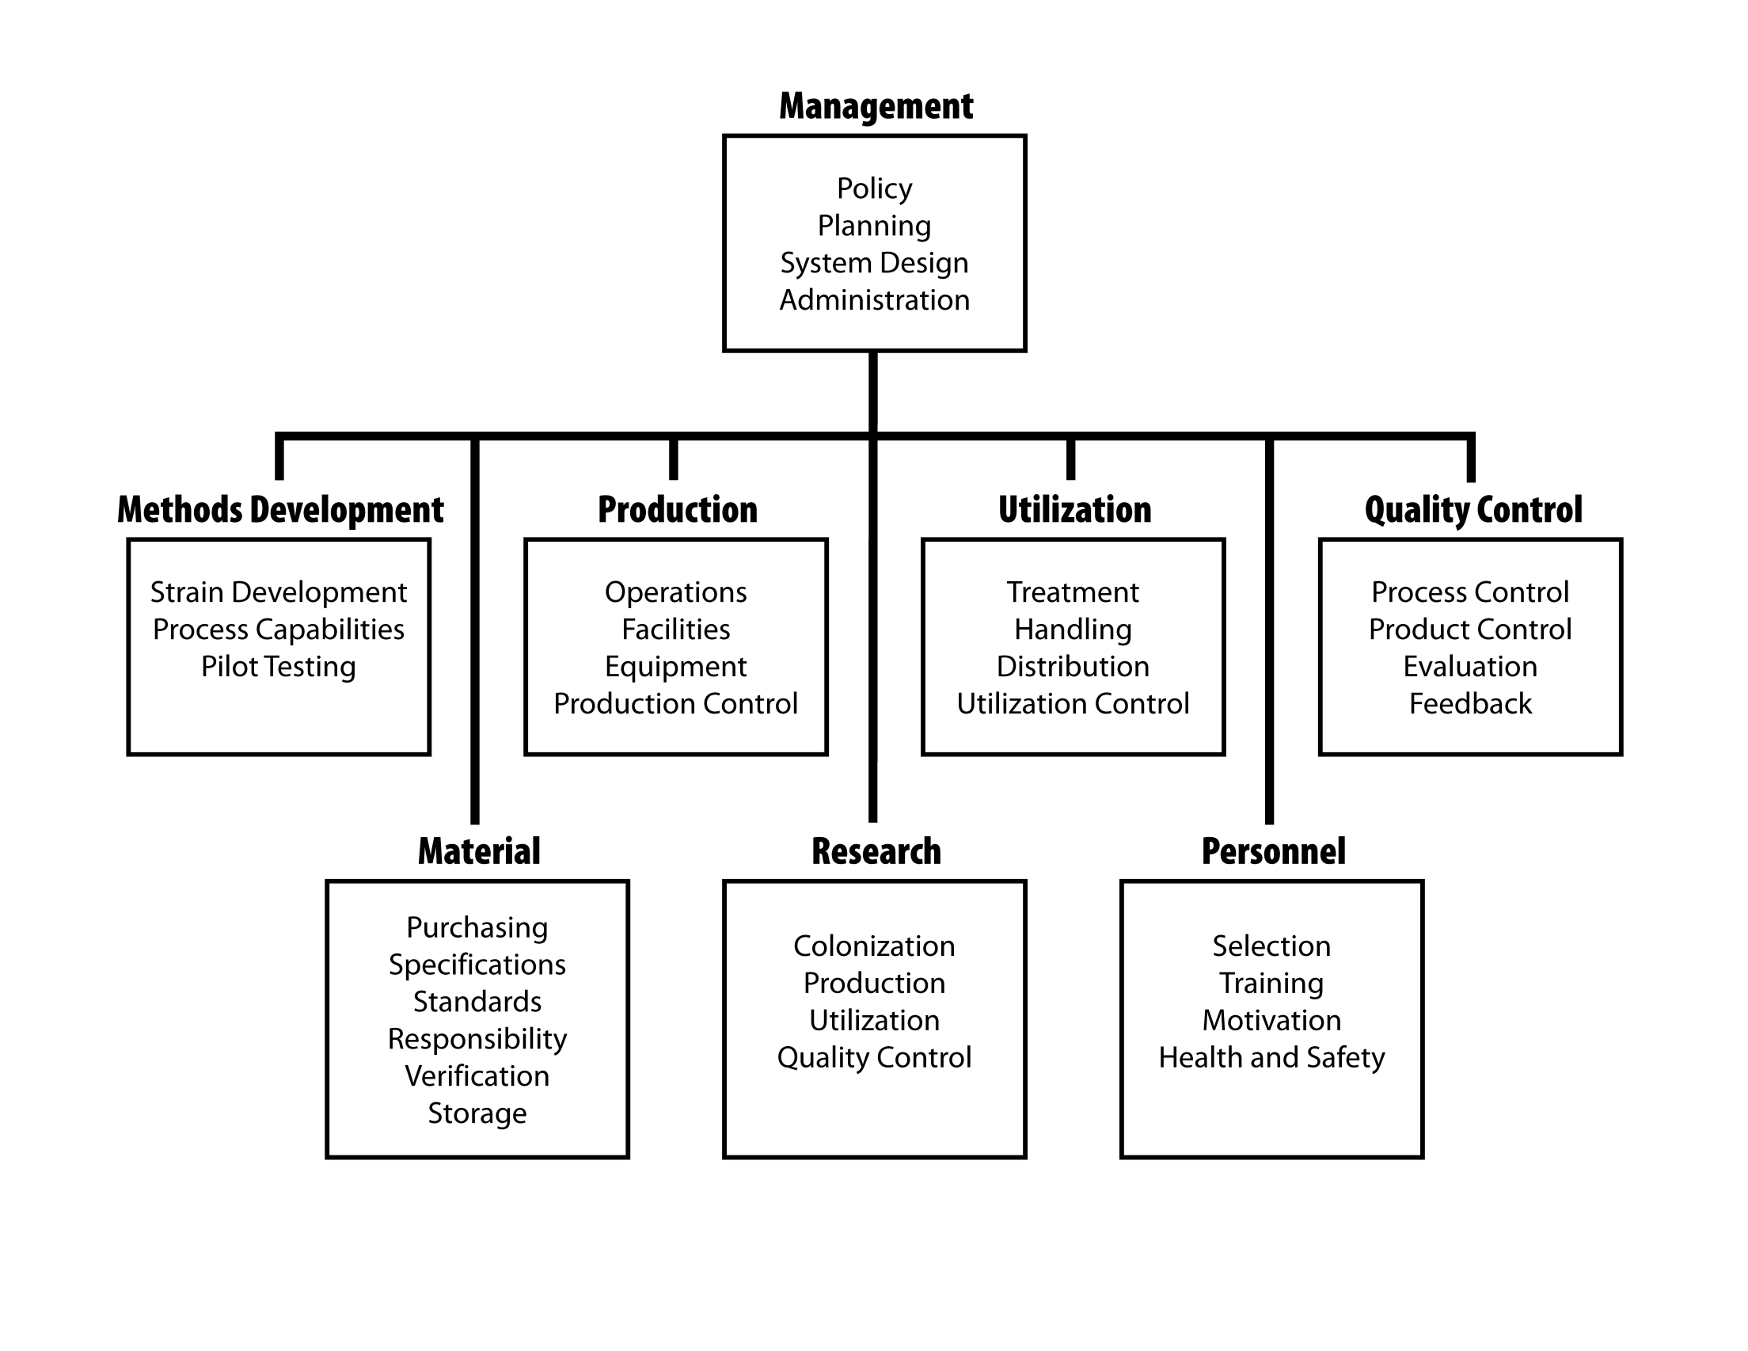

Slide 5
Customer Involvement in Quality Assurance
Customers are more satisfied if they are involved and educated in the release and evaluation of the natural enemy products they purchase.
The most successful producers and suppliers provide technical support to help customers assure that the natural enemies they purchase are effective.
Producers should sub-sample every package or batch for product quality.
Natural enemies should be removed from shipping containers and used immediately.
Customers should be given quick and simple product assessment methods.
Customers should quickly return feedback about product quality to the suppliers who in turn inform the producers to take rapid corrective action.
Producers should be able to control the variables that determine product quality and reliably ship specified numbers of high quality natural enemies.
Suppliers should provide application guidelines and deliver the required number of high quality natural enemies to match the level of pest infestations.

Slide 6
Quality Assessments of Mass-Reared Natural Enemies
Species | Results
Encarsia formosa | Number ok, 41% emerged, 89-95% survival at 2 days
Trichogramma pretiosum | Number low, 86% alive
Chrysoperla carnea | All were C. rufilabis
Hippodamia convergens | Number low, 80% alive, 82-96 % survival at 2 days, 9-22% were parasitized
Encarsia formosa | Arrival time, emergence and flight ability variable, sometimes contained Eretmocerus spp.
Aphidius colemani | Arrival time and emergence variable (61-69%) with just above 50% females, hyperparasitoids, I.D. innacurate, emergence before receipt, parasitism low
Aphidius matricariae | Averaged 1,663.1+17.3 with 71.9+3.6% emerging and 88.9% flying, more consistent that A. colemani
Aphytis melinus | live parasitoids 1-28 days after receipt, sex ratio, and female size variable, 0.393-0.644 females
Additional Species Studied | Parameters
Aphidoletes aphidimyza | Number of live parasitoids, identity, purity, hyperparasites, emergence on arrival, rate of adult emergence, total adult emergence, size (length of hind tibia) or weight, sex ratio, longevity, fertility, fecundity, flight capability (motility), and parasitism
Eretmocerus spp
Trichogramma spp
Splangia cameroni
Orius insidiosus
Epidinocarsis lopezi

Slide 7
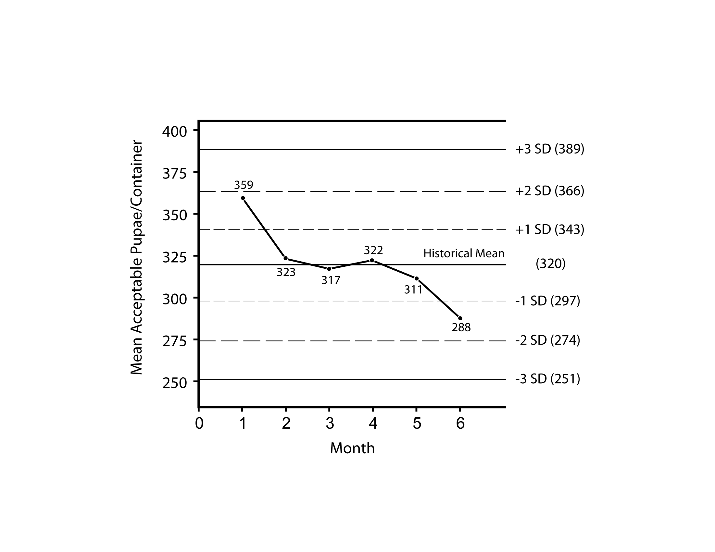
Quality Control Charts

Slide 8
Type of Research | Research Priorities
Feasibility/market analysis | Natural enemy effectiveness in controlling target pests Product development Quality assurance systems
Mass production | Rearing facilities Mechanized equipment Rearing materials Natural and artificial diets Rearing and harvesting techniques Production quality control Process quality control Product quality control
Utilization | Product handling and storage Automated counting technology Improved packaging and shipping Extended use period Efficient scouting techniques Optimal release numbers, rates and timing Mechanized application technologies Efficient product evaluation procedures Utilization quality control
Application environment | Site-specific pest prevention Systems to maximize the effectiveness of natural enemies Natural enemy use with pesticides Systems with multiple products and pests Effectiveness in seasonal and perennial crops

Slide 9

For more information or a copy of this presentation please visit:
http://ipm.ifas.ufl.edu

